Slide 1
Estimating Daily PM2.5 Concentration by Spatial Statistical Downscaling with INLA
Mar 5, 2024

Slide 2
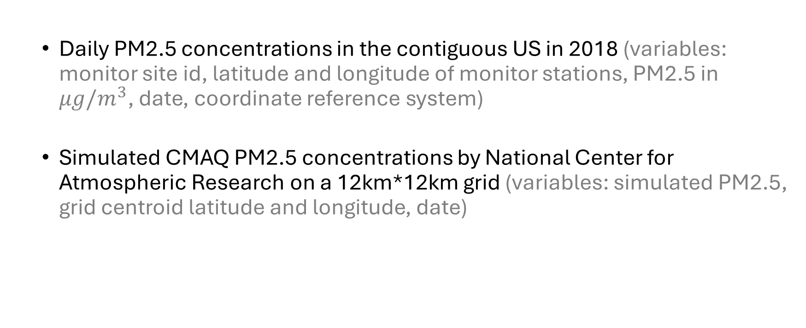
Data
Daily PM2.5 concentrations in the contiguous US in 2018 (variables: monitor site id, latitude and longitude of monitor stations, PM2.5 in $μg/m^{3}$, date, coordinate reference system)
Simulated CMAQ PM2.5 concentrations by National Center for Atmospheric Research on a 12km*12km grid (variables: simulated PM2.5, grid centroid latitude and longitude, date)

Slide 3
Processing Steps
Match PM2.5 monitor to its closest CMAQ grid location using Euclidean distance.
Merge two datasets by date and location.
Project PM2.5 monitor locations in (latitude, longitude) to (km, km).
Divide the dataset into 52 1-week subsets according to dates of measurements.
Note: there were no PM2.5 measurements on 2018-12-31 in the source dataset.
Remove missing and negative PM2.5 measurements.
Note: 2.39% of rows were dropped.

Slide 4
Descriptive Table
Characteristic | Overall, N = 235,402 | Q1, N = 57,494 | Q2, N = 58,285 | Q3, N = 59,741 | Q4, N = 59,882
Daily PM2.5
Mean (SD) | 8.3 (7.3) | 8.0 (6.2) | 7.5 (4.1) | 9.6 (8.1) | 8.3 (9.3)
Range | 0.0, 411.7 | 0.0, 318.8 | 0.0, 167.8 | 0.0, 261.0 | 0.0, 411.7
Simulated CMAQ PM2.5
Mean (SD) | 8.6 (5.6) | 8.4 (5.8) | 7.5 (4.1) | 9.7 (5.7) | 8.7 (6.4)
Range | 0.0, 75.5 | 0.1, 54.3 | 0.1, 44.4 | 0.1, 75.5 | 0.0, 74.4
Monitors
Count | 969 | 936 | 937 | 930 | 939

Slide 5
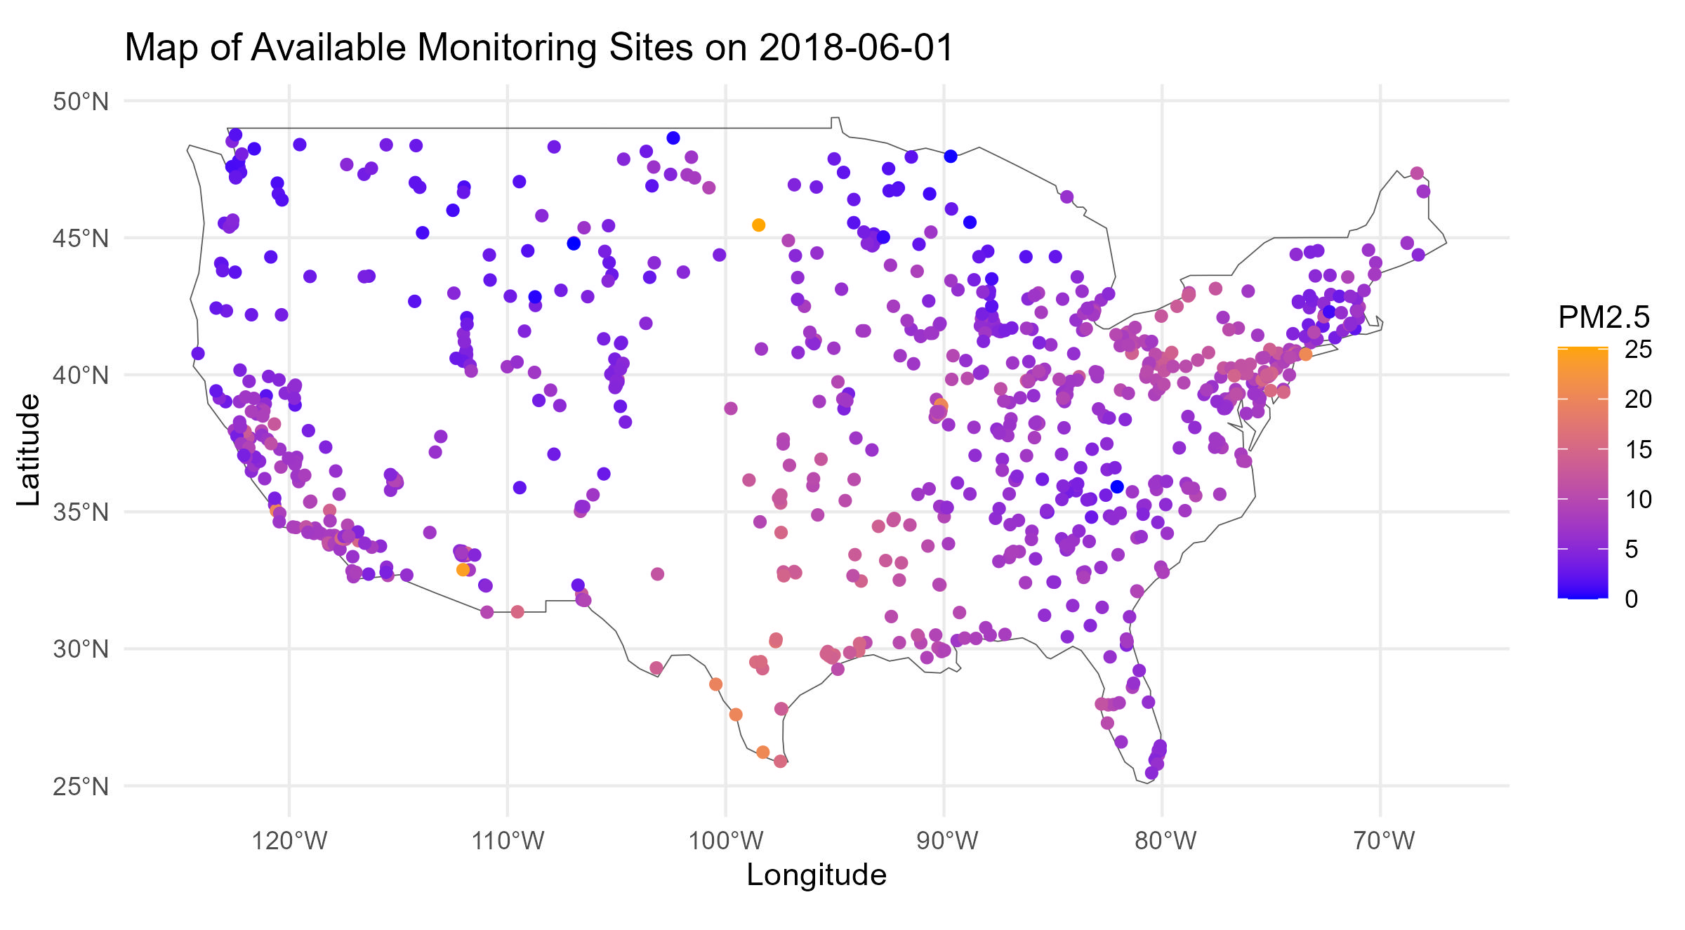
An Example Plot

Slide 6
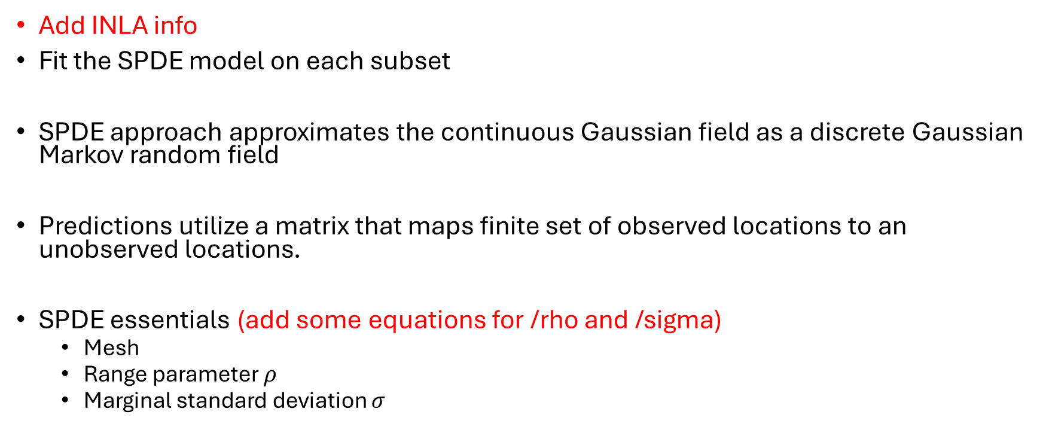
Modelling PM2.5
Add INLA info
Fit the SPDE model on each subset
SPDE approach approximates the continuous Gaussian field as a discrete Gaussian Markov random field
Predictions utilize a matrix that maps finite set of observed locations to an unobserved locations.
SPDE essentials (add some equations for /rho and /sigma)
Mesh
Range parameter $ρ$
Marginal standard deviation $σ$

Slide 7
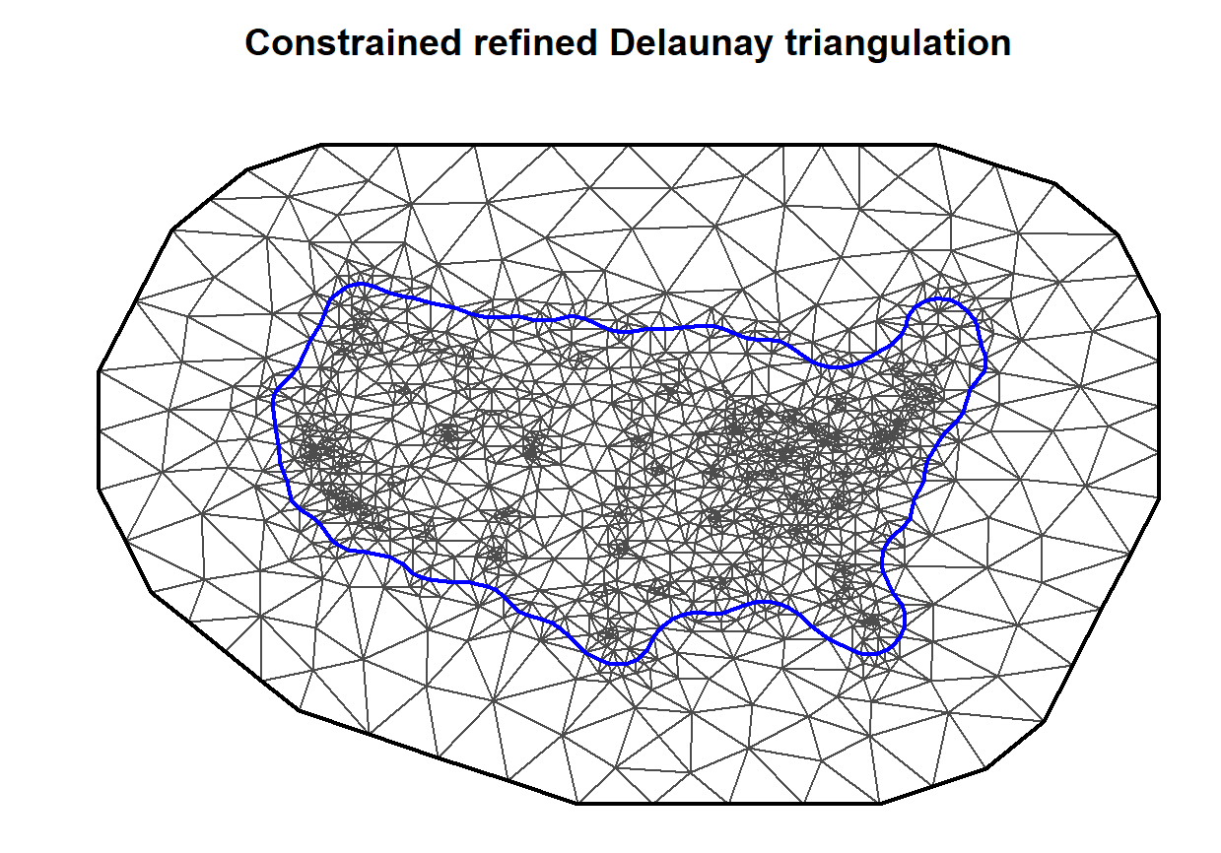
Mesh
On the left: 1 day of PM2.5 concentration distribution
On the right: a mesh example
Points inside the triangles are predicted by the weighted average of vertex values
Alleviate boundary effect

Slide 8
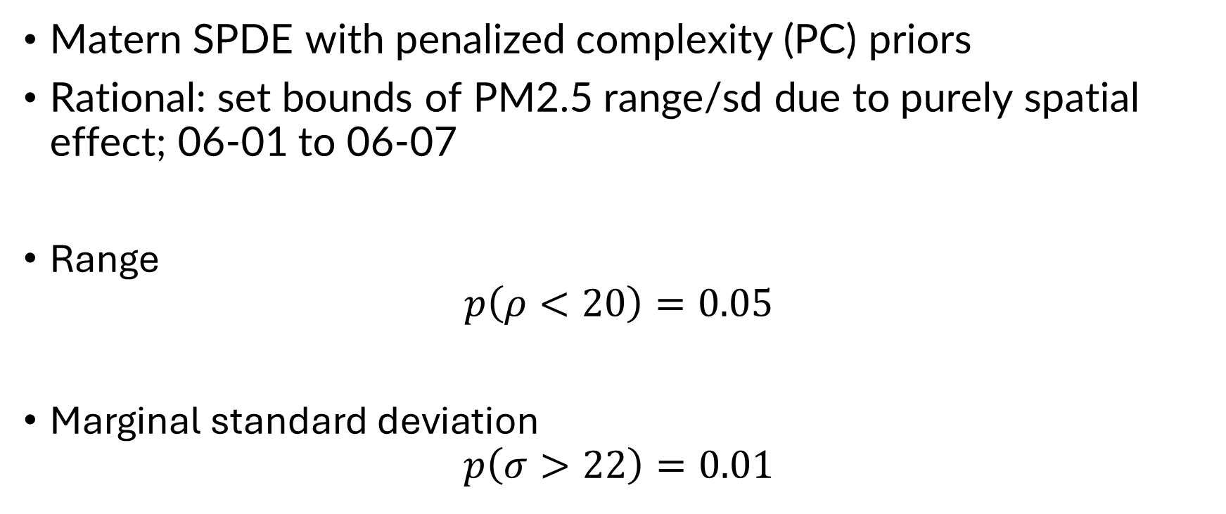
Priors
Matern SPDE with penalized complexity (PC) priors
Rational: set bounds of PM2.5 range/sd due to purely spatial effect; 06-01 to 06-07
Range
$$p\left(ρ<20\right)=0.05$$
Marginal standard deviation
$$p\left(σ>22\right)=0.01$$

Slide 9
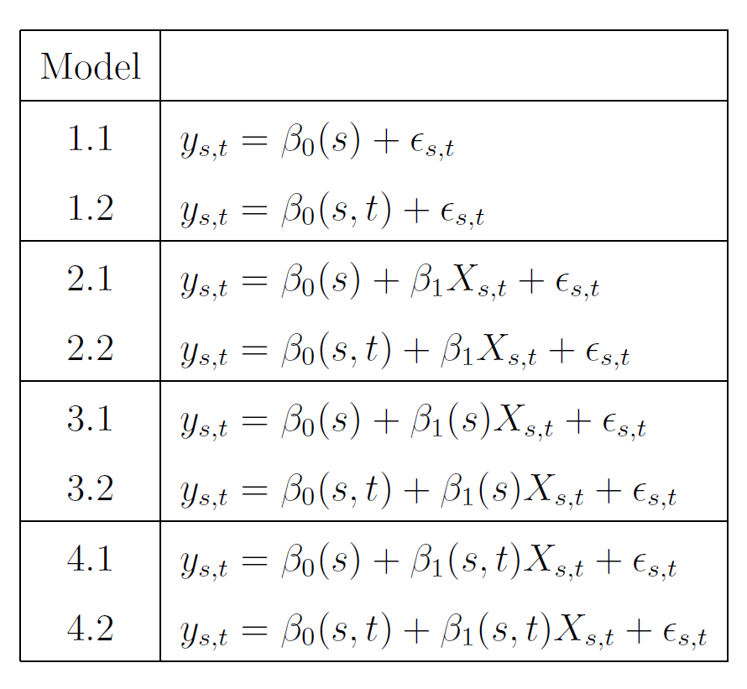
Models
Add descriptions of notation.
epsilon_st ~ N(0, )
Notes:
Pull out summary coeffients

Slide 10
10-fold Spatial Cross-validation
Objective: model selection based on root mean square error and coverage of 95% prediction intervals.
Normally train and test data in CV are independent, but we cannot assume that for spatial data
Solution: exclude disks around test data to reduce dependence

Slide 11
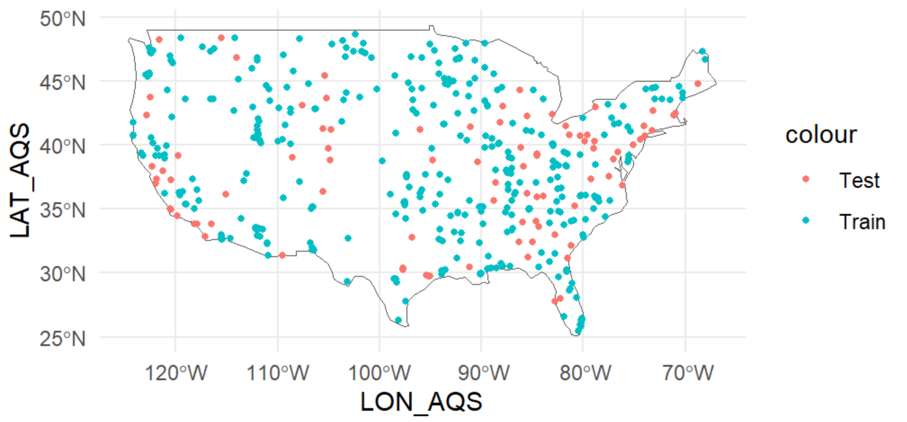
Key (??)
Recall that the dataset contains 7-day measurements of PM2.5. How should we sample for folds? Two options:
Key as (location) – sample for locations : preferred (pick this one and only present this results)
Add title

Slide 12
RMSE by Quarters
Root Mean Square Error
 | Q1 | Q2 | Q3 | Q4 | Overall
Model 1.1 | 5.96 | 4.08 | 7.68 | 9.04 | 6.97
Model 1.2 | 5.96 | 4.08 | 7.68 | 9.04 | 6.97
Model 2.1 | 5.31 | 3.59 | 6.67 | 7.92 | 6.11
Model 2.2 | 5.31 | 3.59 | 6.67 | 7.92 | 6.11
Model 3.1 | 5.79 | 4.01 | 7.24 | 8.05 | 6.48
Model 3.2 | 5.65 | 3.94 | 6.95 | 7.53 | 6.19
Model 4.1 | 5.85 | 4.04 | 7.43 | 8.49 | 6.69
Model 4.2 | 5.75 | 4 | 7.22 | 8.03 | 6.45
No buffer / radius 0km; sample by location
Root Mean Square Error
 | Q1 | Q2 | Q3 | Q4 | Overall
Model 1.1 | 6.02 | 4.11 | 7.73 | 9.15 | 7.04
Model 1.2 | 6.02 | 4.11 | 7.73 | 9.15 | 7.04
Model 2.1 | 5.38 | 3.62 | 6.82 | 8.19 | 6.26
Model 2.2 | 5.38 | 3.62 | 6.82 | 8.19 | 6.26
Model 3.1 | 5.98 | 4.09 | 7.52 | 8.96 | 6.9
Model 3.2 | 5.94 | 4.06 | 7.35 | 8.79 | 6.79
Model 4.1 | 6 | 4.1 | 7.63 | 9.06 | 6.97
Model 4.2 | 5.97 | 4.08 | 7.53 | 8.97 | 6.9
Radius 100km; sample by location
Root Mean Square Error
 | Q1 | Q2 | Q3 | Q4 | Overall
Model 1.1 | 6.1 | 4.16 | 7.81 | 9.27 | 7.12
Model 1.2 | 6.1 | 4.16 | 7.81 | 9.27 | 7.12
Model 2.1 | 5.46 | 3.69 | 7.08 | 8.38 | 6.42
Model 2.2 | 5.46 | 3.69 | 7.08 | 8.38 | 6.42
Model 3.1 | 6.1 | 4.16 | 7.73 | 9.25 | 7.09
Model 3.2 | 6.1 | 4.16 | 7.66 | 9.24 | 7.07
Model 4.1 | 6.1 | 4.16 | 7.78 | 9.26 | 7.11
Model 4.2 | 6.1 | 4.16 | 7.74 | 9.25 | 7.1
Radius 200km; sample by location
Notes:
Add coverages

Slide 13
95% Prediction Interval Coverage by Quarters
Notes:
Add coverages

Slide 14
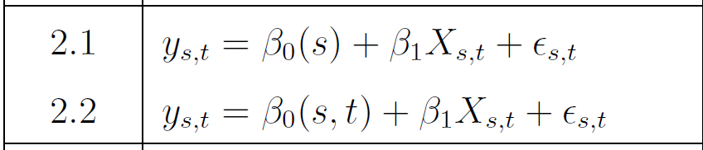
Conclusion
Model 2.1 and 2.2 are preferred with the smallest RMSE’s

Slide 15
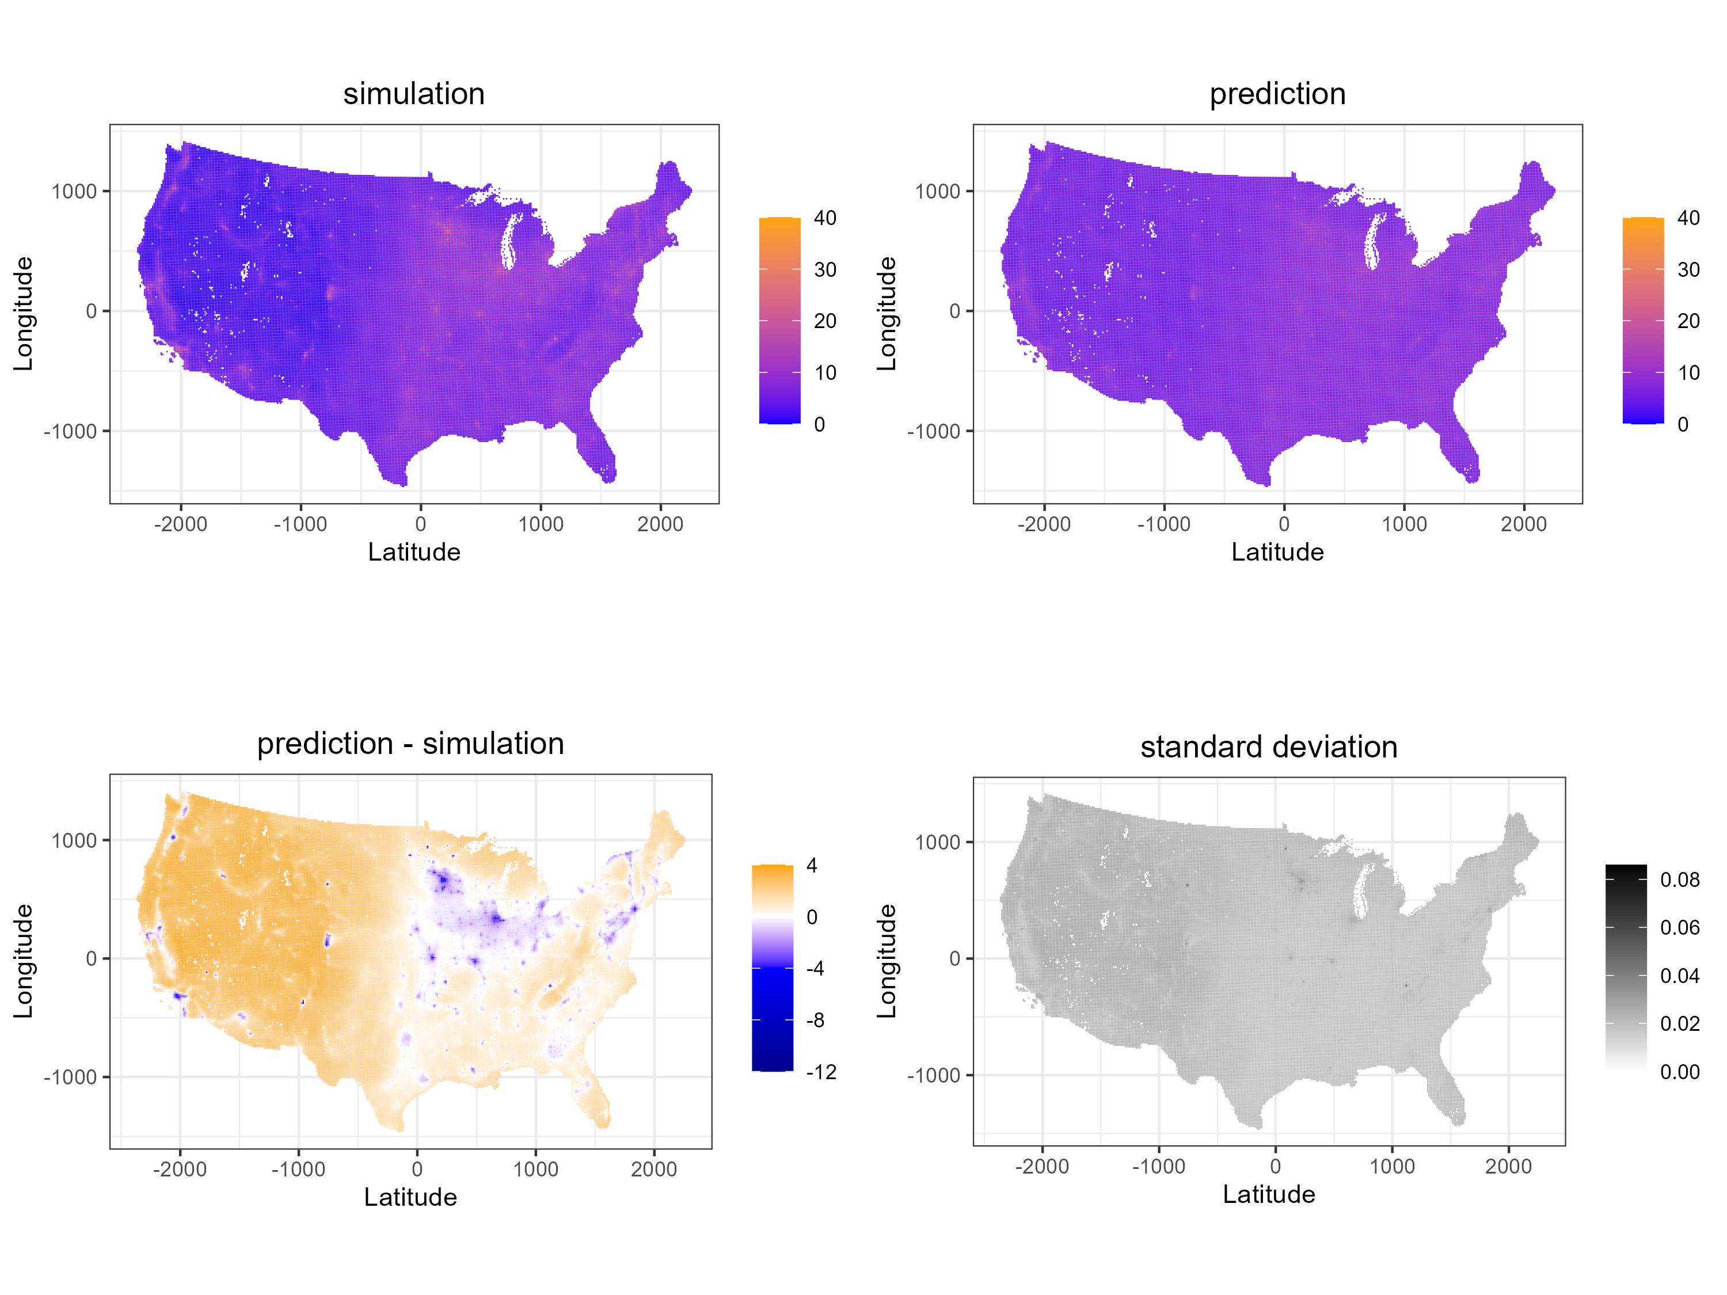
Q1 Average Value Plots

Slide 16
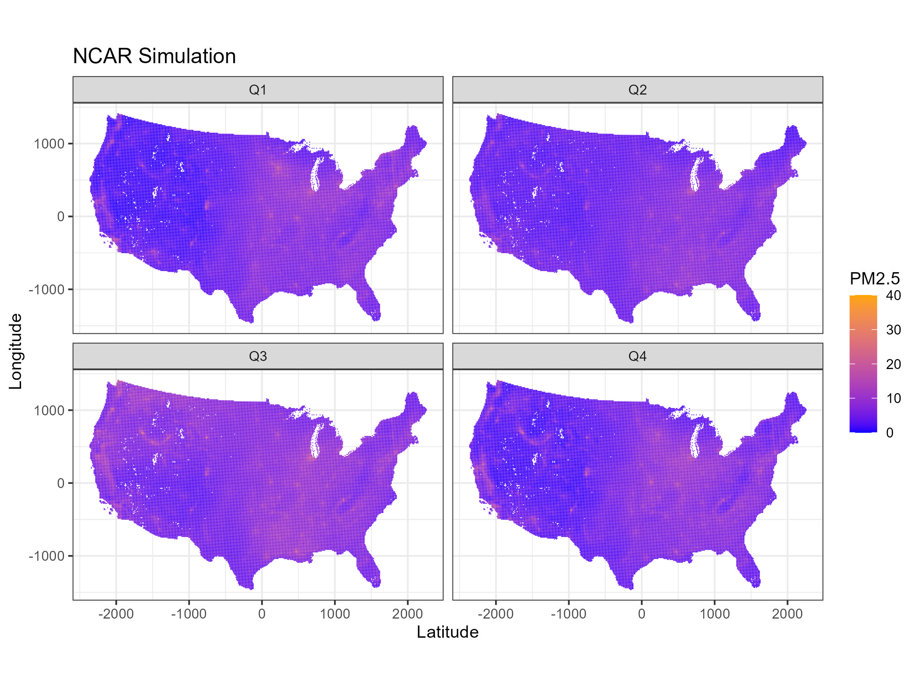

Slide 17
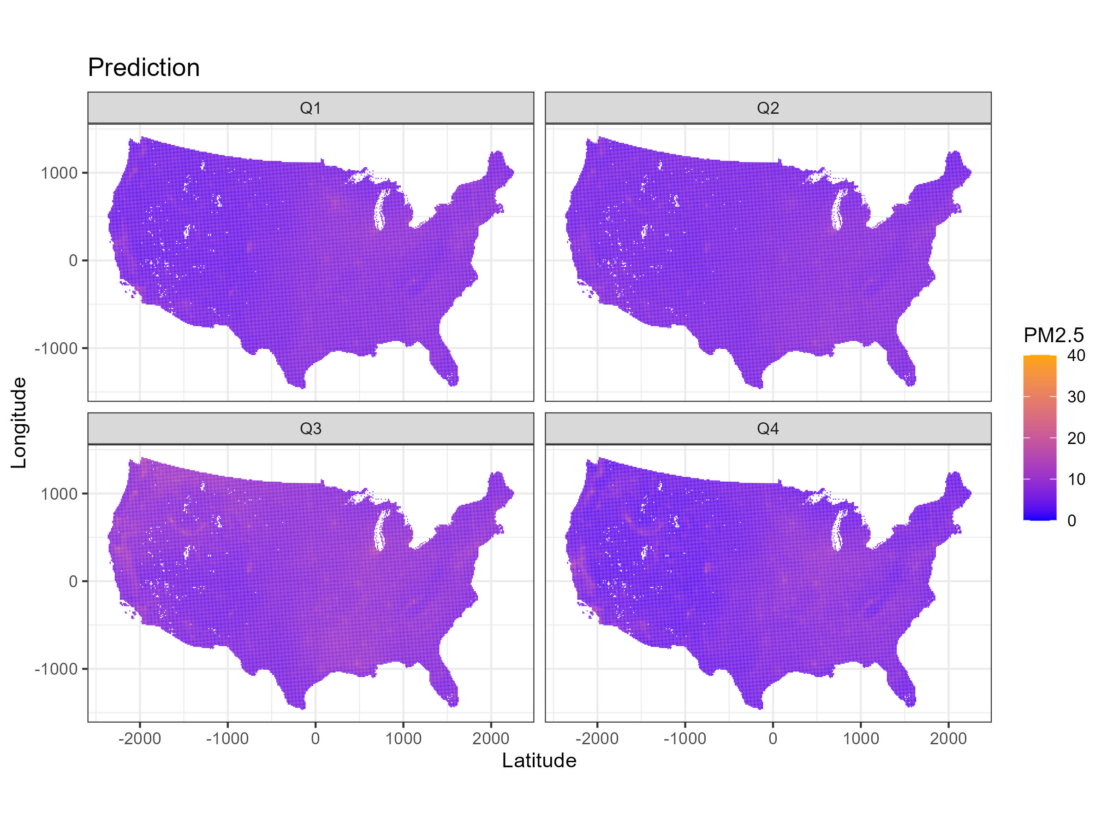

Slide 18
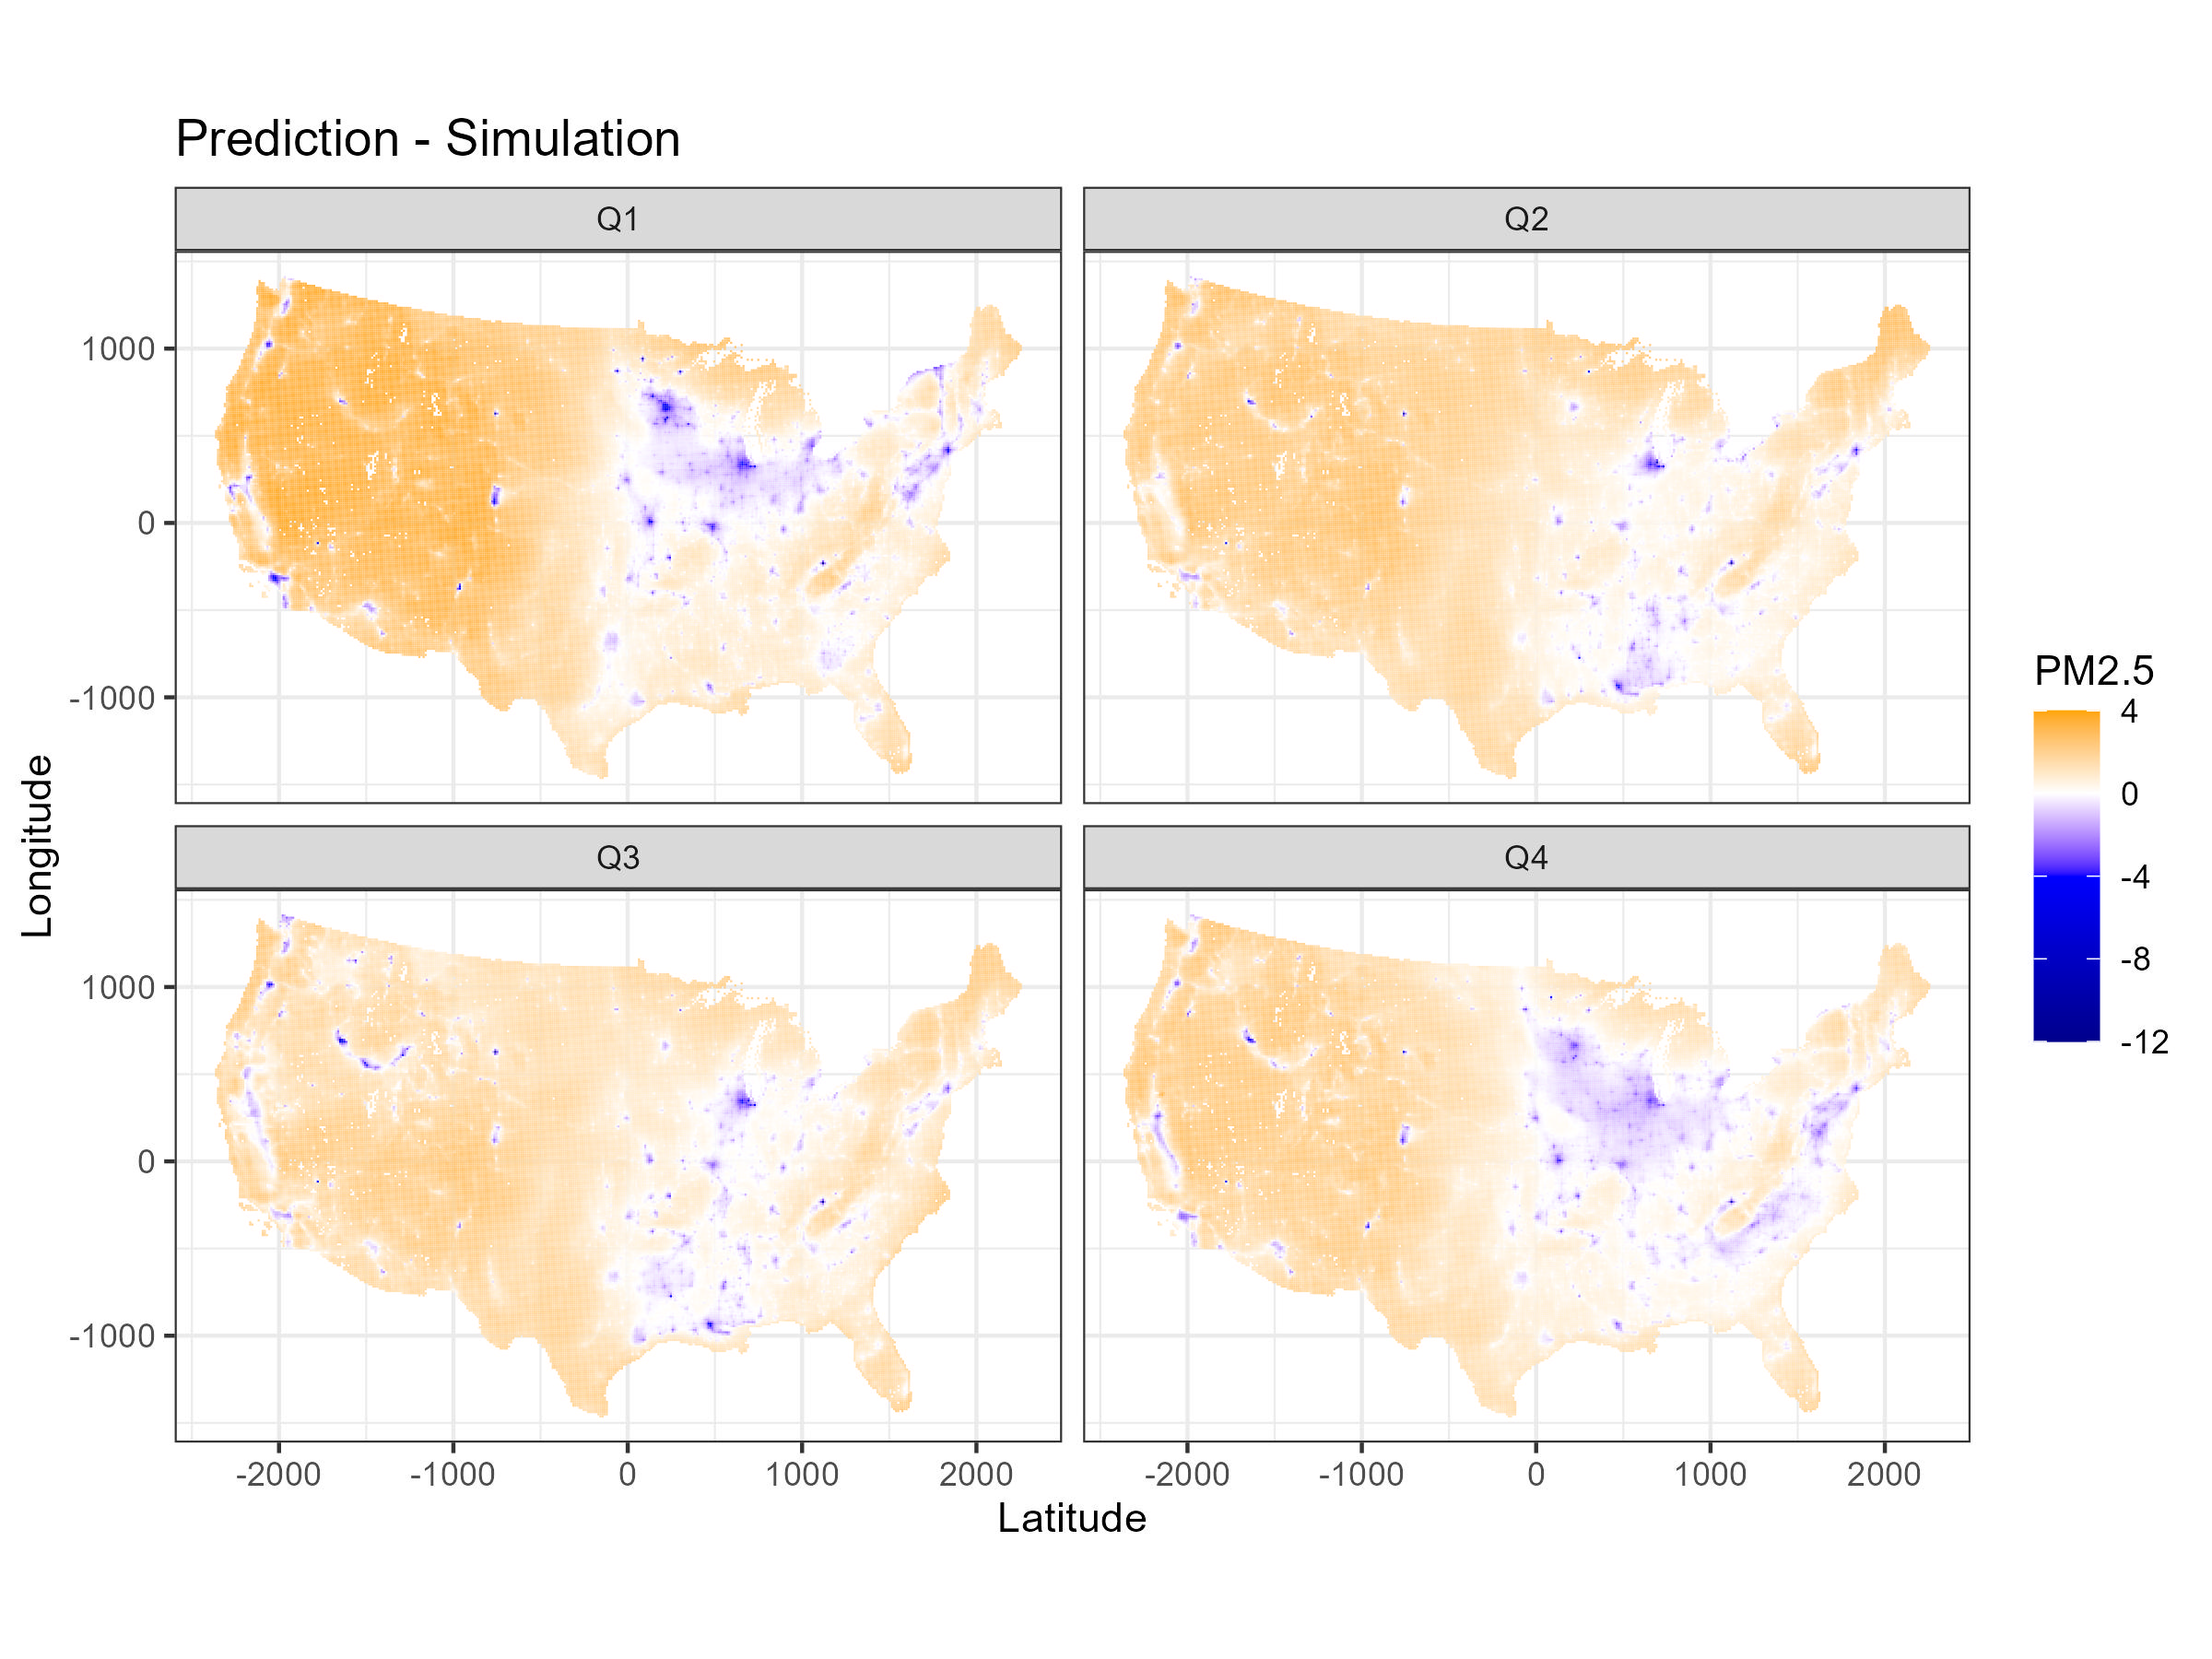

Slide 19
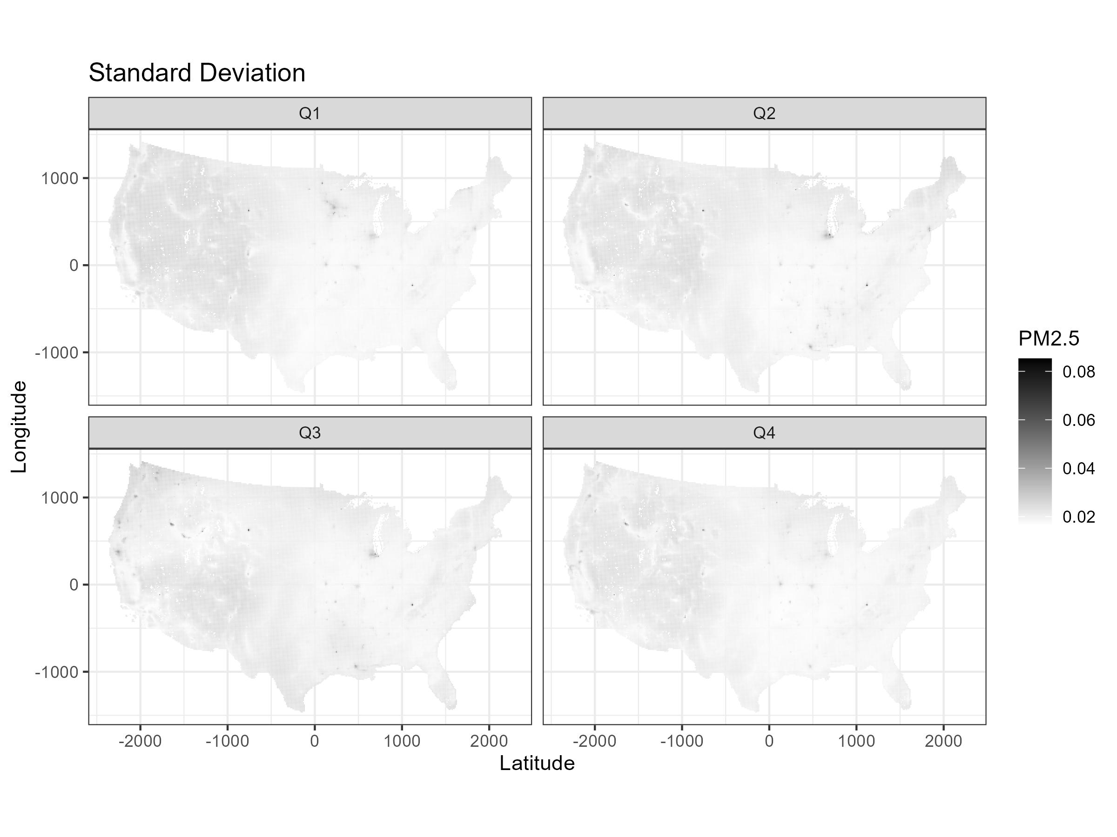

Slide 20
Appendix: scripts
 | Objective | Sampling Method | Buffer Radius | Data Source
script1 | Perform 10-fold CV | (Location, Day) | 100km | Specify 7 consecutive days
script2 | Perform 10-fold CV | (Location, Day) | 100km | Divide 365 days into 13*4 7-day windows
script3 | Create summary tables | - | - | Import outputs of script 2, 4, 5, 6
script4 | Perform 10-fold CV | (Location) | 100km | Divide 365 days into 13*4 7-day windows
script5 | Perform 10-fold CV | (Location) | 0km | Divide 365 days into 13*4 7-day windows
script6 | Perform 10-fold CV | (Location) | 200km | Divide 365 days into 13*4 7-day windows

Slide 21
Appendix: notes
Need to binary install INLA for HPC cluster
Library caret used to create folds does not work in cluster R sessions
soln: manually create folds using for loops
Coding error in defining buffers gets fixed
INLA crashes at some iterations (10th for script 1, many more for script 2) with errors reported as "fails to get good initial values"
soln: using pcmatern for SPDE, adding initial values for hyperparameters using script 1 results
Numerical issue: In script 2 inla.mesh.2d() takes forever to run in some job
problem caused by specifying boundary layer using max.edge = c(300, 600)
soln: round loc argument to 5 digits
soln: tune max.edge, offset arguments in inla.mesh.2d(); define and specify boundary using all monitor locations

